Slide 1


Team 30: ECEN 215 Lab Kit
Bi-Weekly Update 2 Members: Luis Diaz-Santini, Yusuf Hossain,
Ryan Freed, and Peter Zhang Sponsor: Dr. Lusher
TA: Garret Brown
Notes:
Intro should take 30 seconds

Slide 2
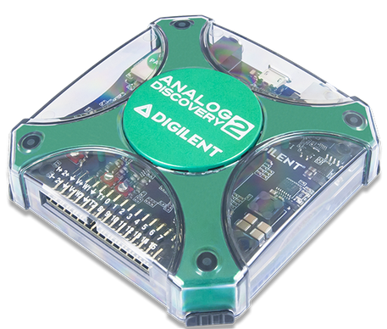
Project Summary
Problem Statement:
Principles of Electrical Engineering (ECEN 215) teaches the basics of electric circuit analysis and electronics to non-ECEN majors.
The transition of ECEN 215 to an online format poses a challenge due to its lab component relying on the Analog Discovery 2 (AD2), which is expensive.
Solution Proposal:
The ECEN 215 Lab Kit offers a solution to the cost, convenience, and over complication issues that are abundant with the AD2. Aiming for a $50 price point, the lab kit offers a more catered simpler approach to each lab while also making it possible to complete at home.
Will operate as the power supply, signal generator, multimeter, and Oscilloscope.

Slide 3
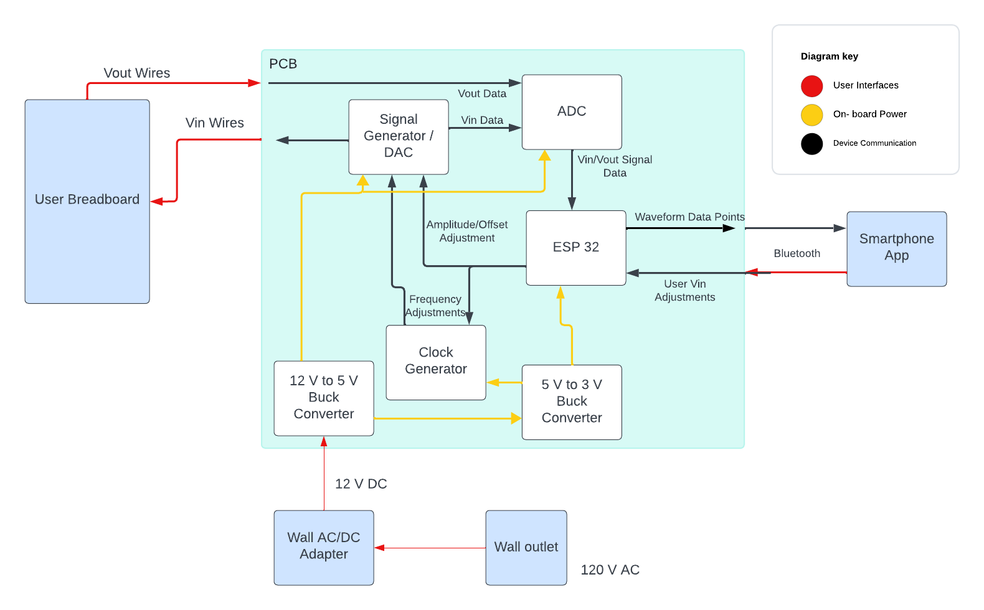
Subsystems Overview
Peter:
Multimeter and Oscilloscope
Yusuf:
Waveforms and communicating to the microcontroller.
Luis:
Create mobile application to interface with device
Ryan:
PCB design and power.

Slide 4
Project Timeline
Ensure Working Subsystem (completed 8/22) | Research Integrating / Ensure Working Subsystems (completed 8/29) | Integrate App with Wave Gen and Oscilloscope (to complete by 9/24) | Integrate App with Multimeter (to complete by 10/16) | Complete Testing and Validation of Integrated Subsystems (to complete by 10/30) | Documentation and Buffer Time (to complete by 11/10)

Slide 5
Oscilloscope and Multimeter
Peter Zhang
Accomplishments since last update 16 hrs of effort | Ongoing progress/problems and plans until the next presentation
Advertise and establish a connection to mobile application via Bluetooth | Send data to mobile application for graphing oscilloscope Remodeling ohmmeter and ammeter Improve safety of probes

Slide 6
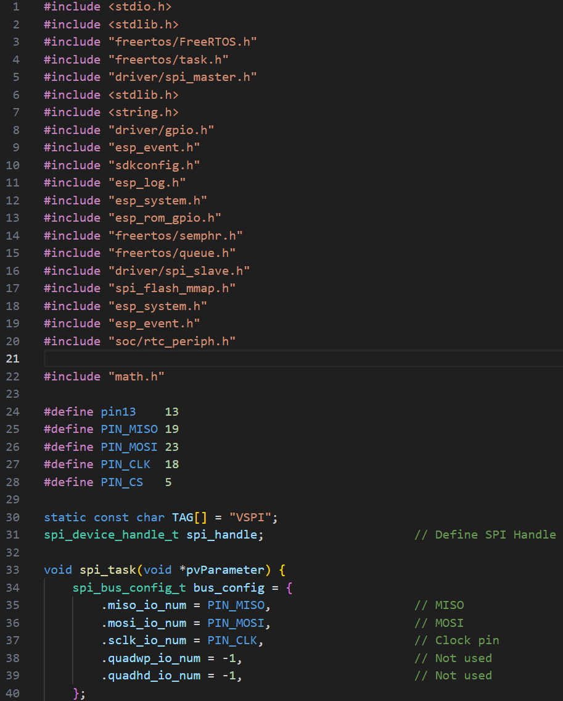
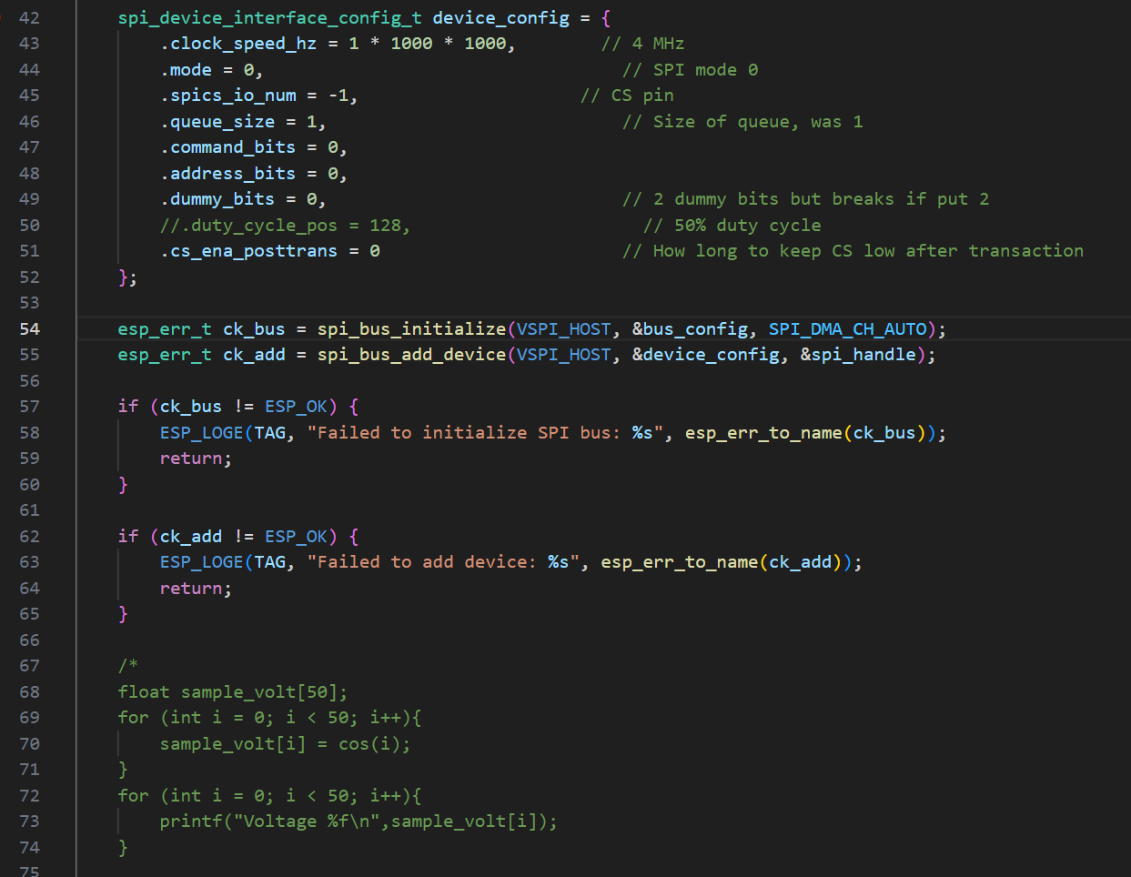
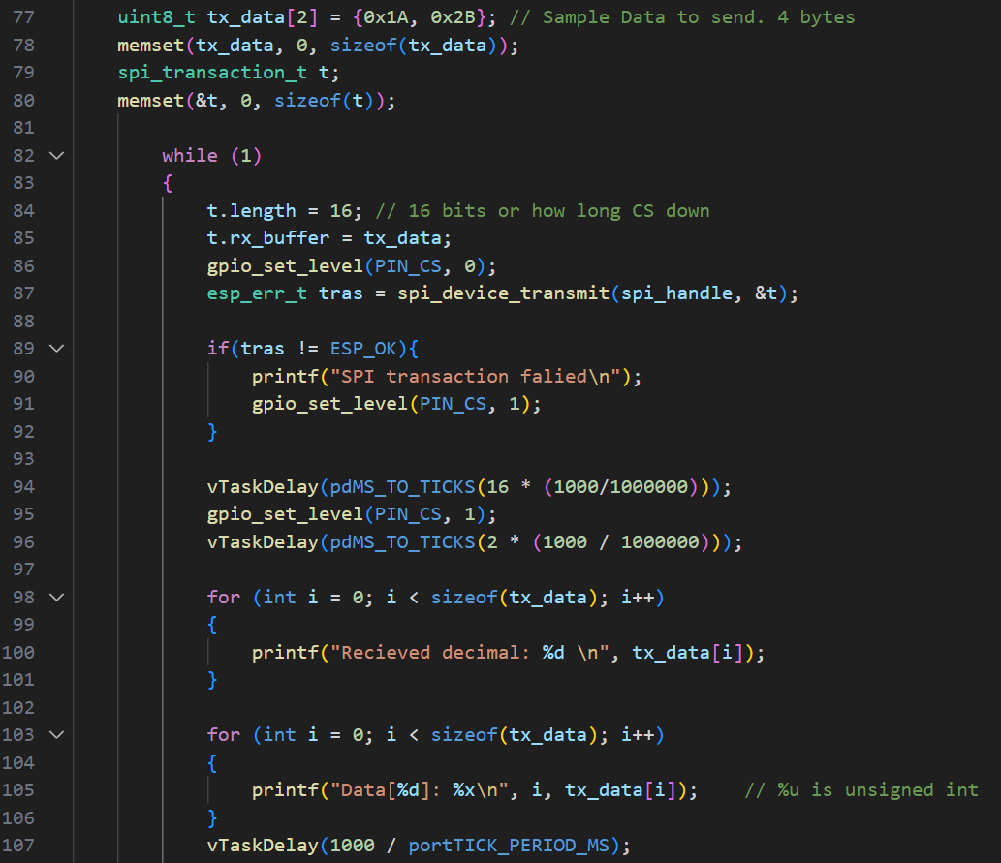
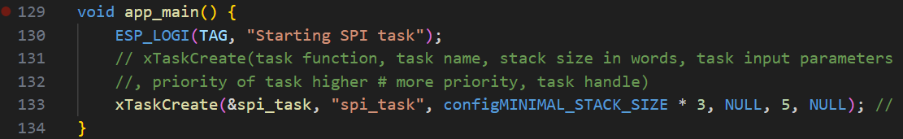

Oscilloscope and Multimeter
Peter Zhang

Slide 7
Waveform Generator
Yusuf Hossain
Accomplishments since last update 10 hrs of effort | Ongoing progress/problems and plans until the next presentation
Mobile Application can send and receive data from Waveform generator | Store and display points from the Wavegen to the app Make functions In the app that can adjust characteristics of the waveforms

Slide 8
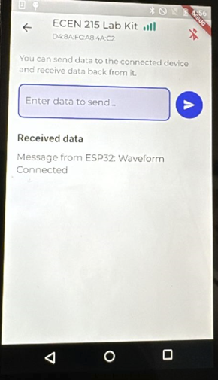
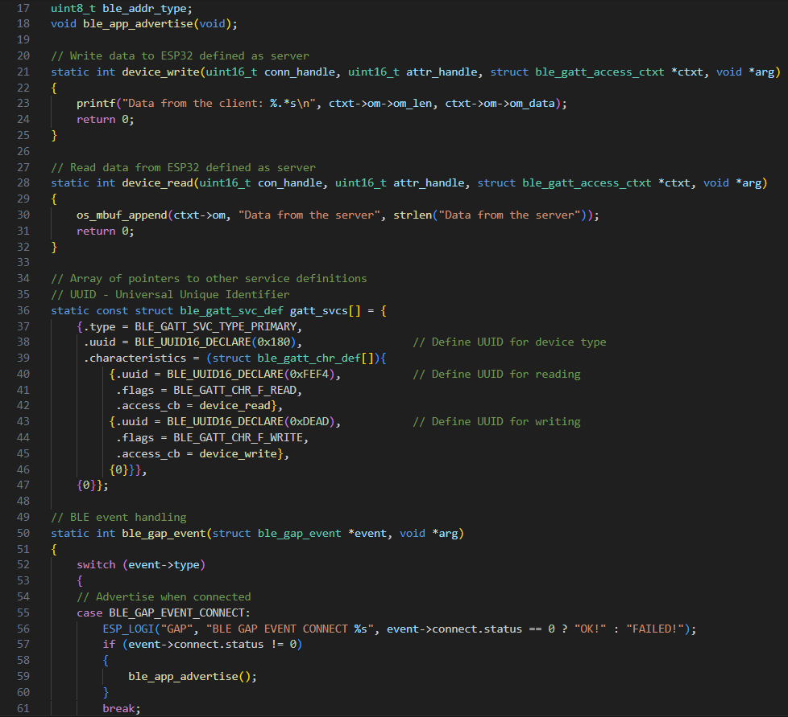
Waveform Generator
Yusuf Hossain

Slide 9
Mobile App
Luis Diaz-Santini
Accomplishments since last update 20 hrs of effort | Ongoing progress/problems and plans until the next presentation
Bluetooth functionality using Espressif IDF has been implemented Application is able to send/recieve messages to and from waveform generator | Fine tune Espressif code to communicate more accurately with waveform generator Begin implementation of oscilloscope functionality on application

Slide 10
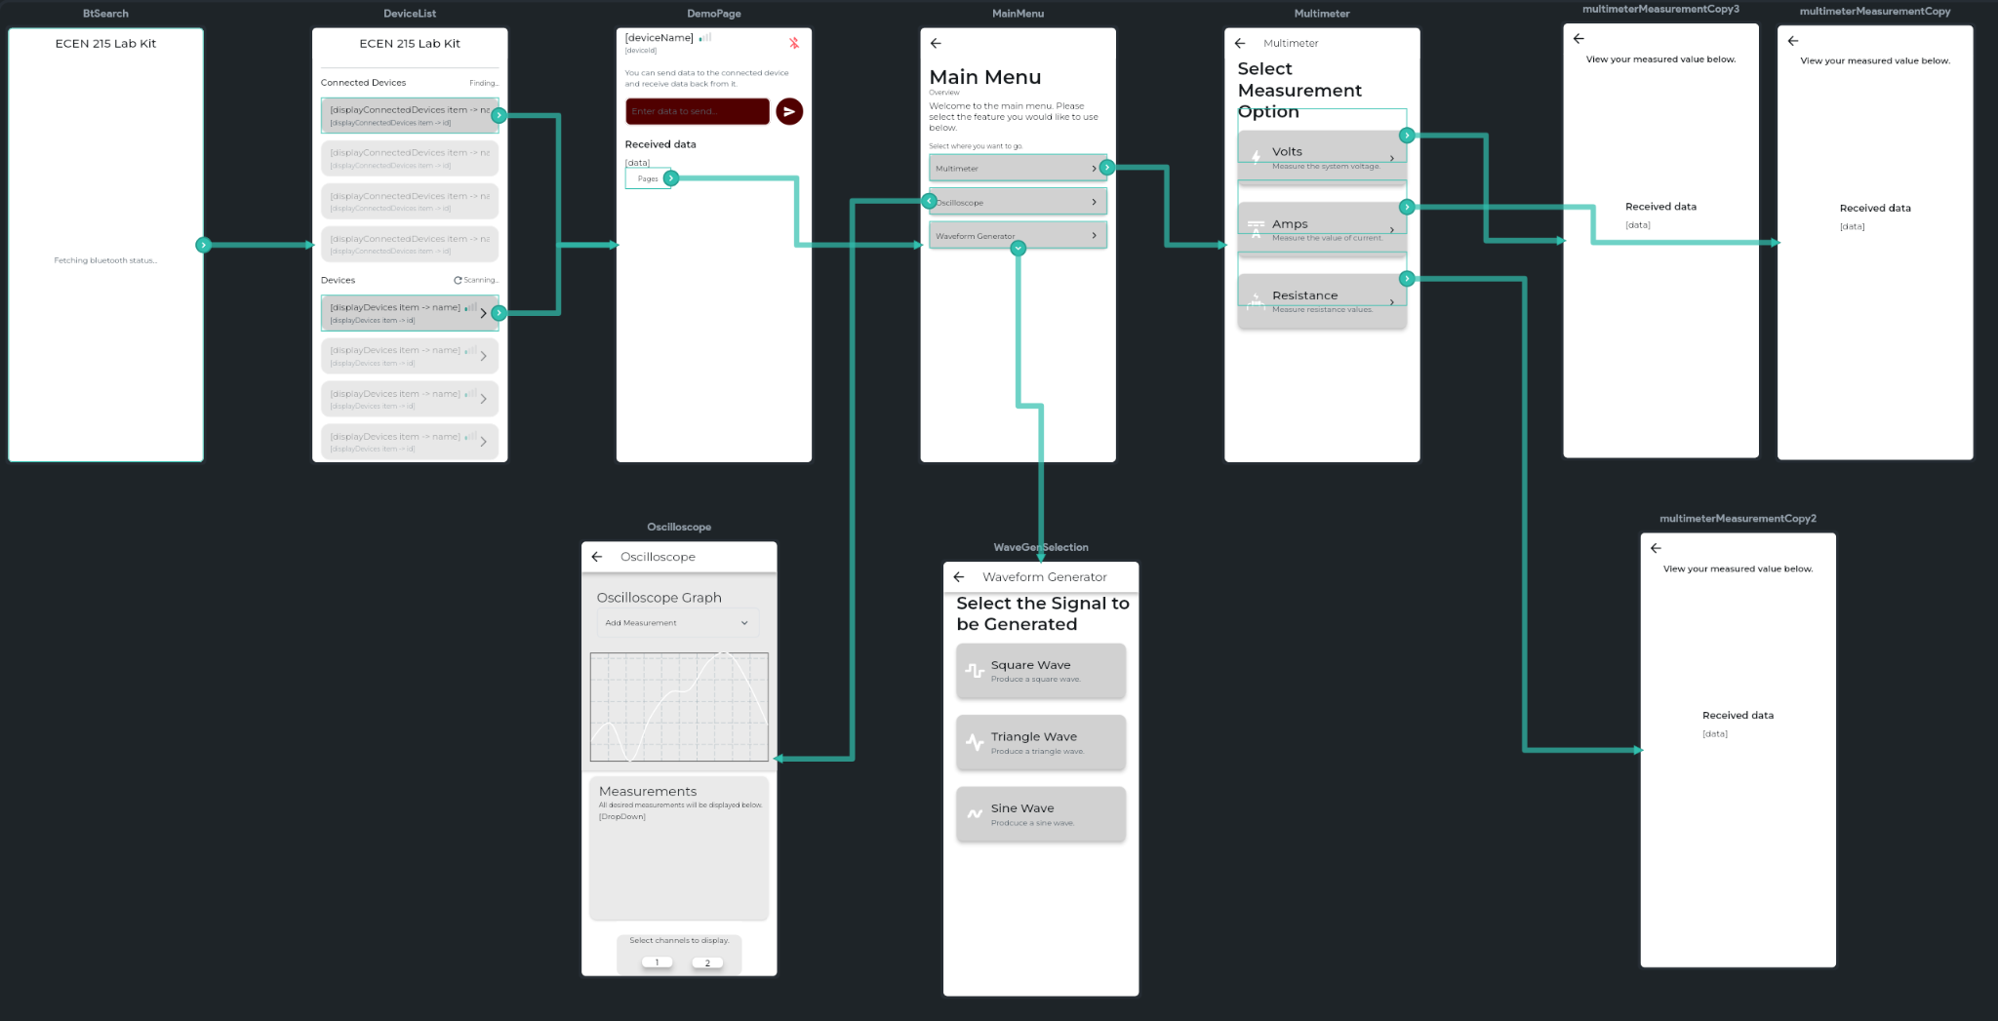
Mobile App
Luis Diaz-Santini

Slide 11
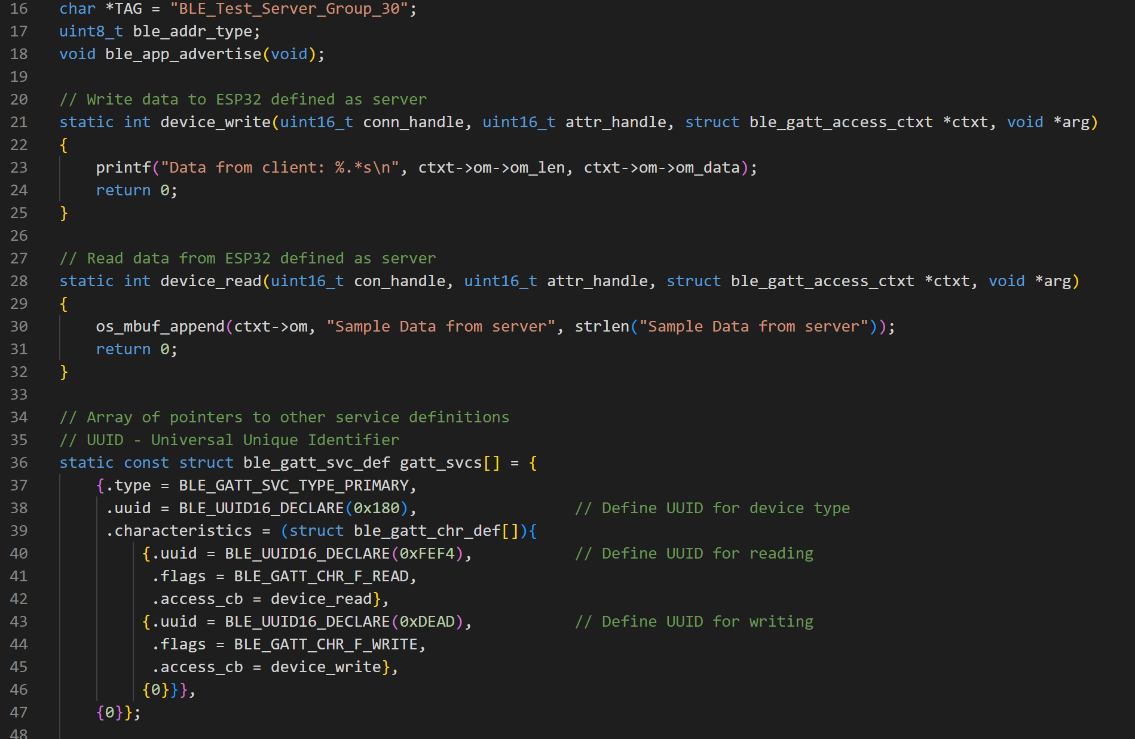
Mobile App
Luis Diaz-Santini

Slide 12
PCB and Power
Ryan Freed
Accomplishments since last update 24 hrs of effort | Ongoing progress/problems and plans until the next presentation
Completed PCB case model 1 Fixed artifacting issue in PCB document Ordered PCB and stencil Completed design sanity check | Receive board and solder on components Add amp buffers to protect chips on board Troubleshoot and fix any potential issues

Slide 13
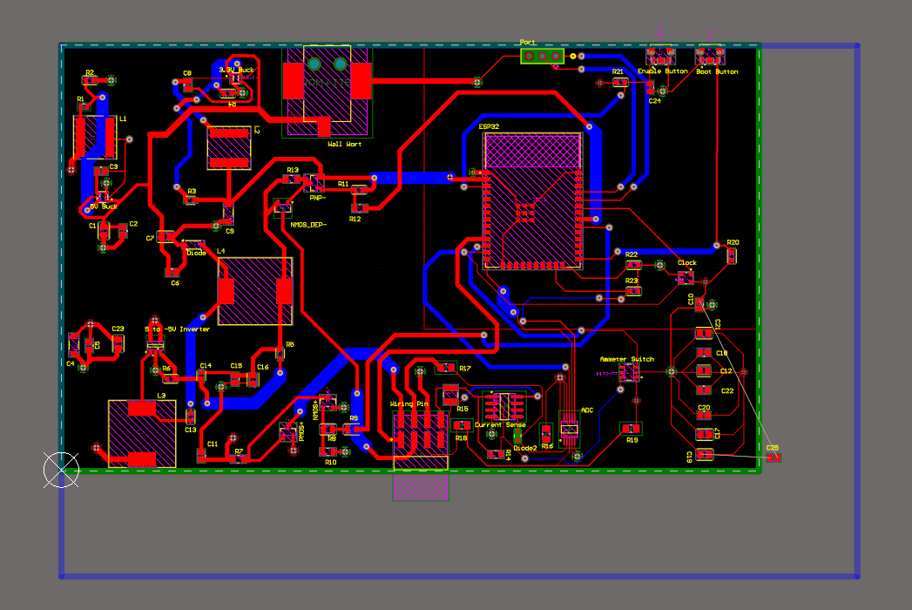
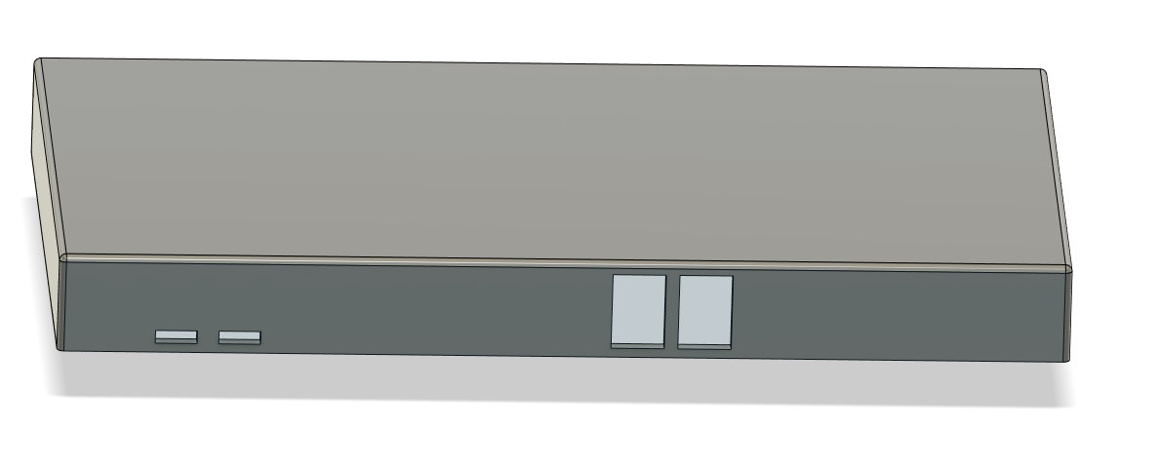
PCB and Power
Ryan Freed
Case Artifacting

Slide 14
Parts Ordering Status
PCB and stencil ordered
Ordering op amps before next presentation
Notes:
Michelle

Slide 15
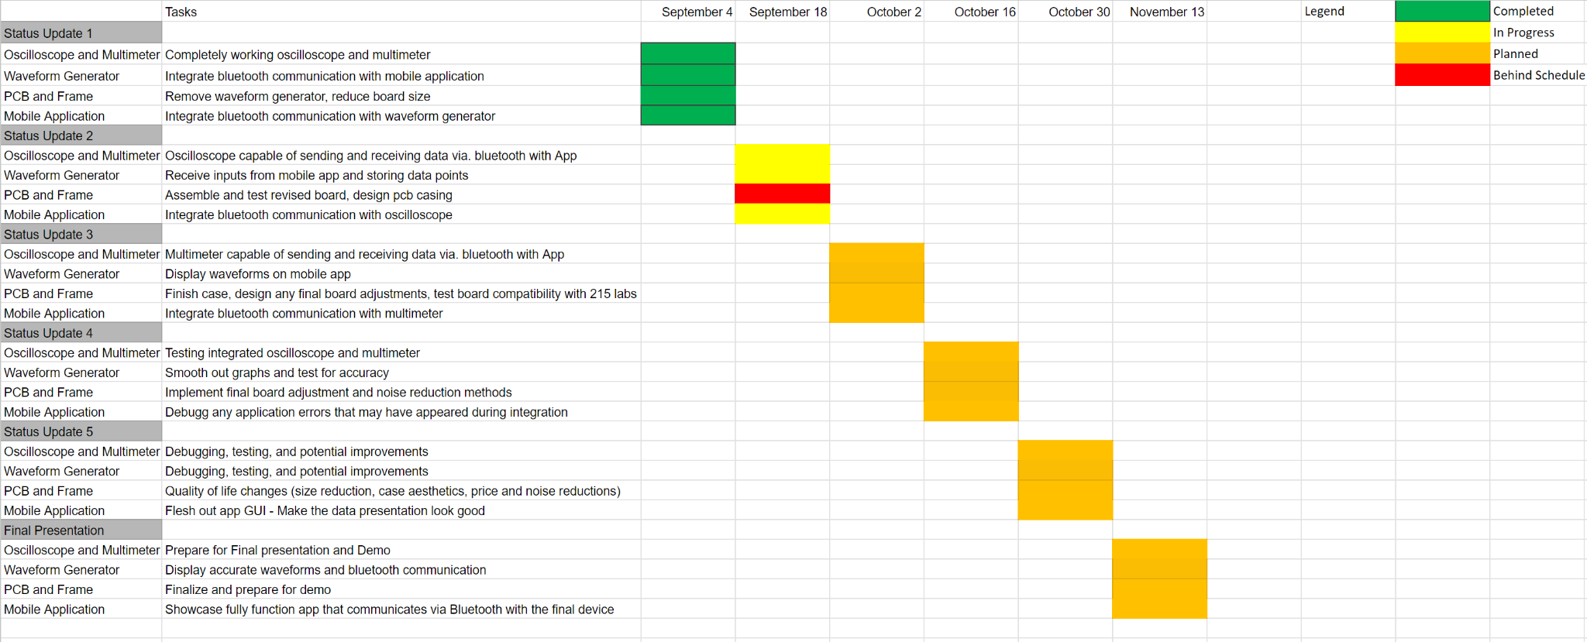
Execution Plan
Notes:
Michelle

Slide 16
Thank you

